Slide 1


Propulsion Motor Shipboard Power System Fundamentals Revision of 1 February 2026
Dr. Norbert Doerry
http://doerry.org/norbert/MarineElectricalPowerSystems/index.htm
© 2026 by Norbert Doerry This work is licensed via: CC BY 4.0 (https://creativecommons.org/)

Slide 2
Essential Questions
What components comprise a Propulsion Motor subsystem? | Remember
What is the impact of operational profiles on propulsion motor subsystem design? | Understand
What are the control modes for a propulsion motor and when should each be used? | Understand
What are the sources of losses in a propulsion motor and how are they calculated? | Apply

Slide 3
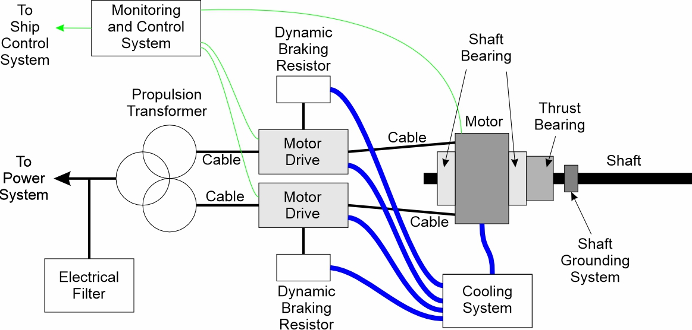
Components of a propulsion motor subsystem
Propulsion Motor
Motor Drive
Propulsion Transformer
Electrical Filters
Dynamic Braking Resistor
Shaft Bearings
Thrust Bearing
Cooling System
Monitoring and Control System
Shaft Grounding System
Cables

Slide 4
Propulsion Motors
Synchronous Motors
Most common
Rotating field coil powered by exciter
Shaft speed proportional to frequency of power provided to it.
Permanent Magnet Motors
Synchronous motor with field coil replaced by permanent magnet
More power dense and efficient than synchronous motor
Usually more expense than synchronous motor
Induction Motors
Current induced into field coil
Rugged and robust, but less power dense and efficient than synchronous motor
May be less expensive than synchronous motor
Direct Current Motors (brushed commutator)
Once very common, seldom used in new designs
Brushes limit operating voltage to 1 kV
High maintenance costs associated with brushes
Superconducting Motors
Synchronous motors with either or both the field winding and/or stator winding made of superconducting wires.
Can be very power dense and more efficient than synchronous motors
High cost
Homopolar Motors
Direct Current machines without commutator
Low voltage – high current machines
Very power dense and efficient
High cost

Slide 5
Motor Drive
Converts power of the type provided by the electrical distribution system (or propulsion transformer) to the type needed by the motor.
Also controls the dynamic braking resistor when performing a crash back maneuver.
DC Link Converter.
Front end stage converts the input power to dc (voltage or current)
Passive (diode rectifier) – high harmonic currents
Active (power electronics) – better control of current waveform properties
Inverter stage converts the dc to the type needed by the motor
Cycloconverter.
Directly converts ac of one frequency to ac of a lower frequency
Lower frequency may result in larger propulsion motor
High harmonic currents at interface with power system

Slide 6
Propulsion Transformer
Usually converts three phase power from the electrical distribution system to six or more phases for use by the motor drive.
More phases can reduce harmonic currents at interface with the electrical distribution system.
Can also produce power at the voltage needed by the motor drive.
Reduces common mode currents entering or leaving the connection to the electrical power distribution system.
May be omitted if the motor drive and electrical power system interfaces are compatible.

Slide 7
Electrical Filters
Used to reduce non-fundamental frequency components of the currents at the interface with the electrical power distribution system.
Goal is to achieve interface standards
Can address both “differential mode” and “common mode” currents.
Can be either passive (no power electronics) or active (with power electronics).

Slide 8
Dynamic Braking Resistors
Used to dissipate regenerative power in motor drives that are not able to provide the power back onto the power system.
The regenerative power is extracted from the rotational energy of the shaft (not the ship) during a crash-back maneuver.

Slide 9
Shaft and Thrust Bearings
Shaft bearings
Support the shaft.
Ensure proper shaft alignment.
May be integrated into motor housing.
Thrust bearing
Transfer longitudinal thrust from the propeller shaft to the ship’s hull and structure.
May be located on either end of the motor.

Slide 10
Cooling System
High power components may require cooling
Motor
Motor drive
Dynamic braking resistor
Electrical Filter
May have multiple “loops”
Air
Glycol-water mixtures
Fresh water
Sea water (intake and discharge overboard)

Slide 11
Monitoring and Control System
Functions:
Coordinate embedded controllers.
Monitor sensors.
Interact with overall ship-wide machinery control system.
Implement control modes.
Establish set-points for the embedded controllers.
May be …
Integrated with the motor drive controller.
Stand alone.

Slide 12
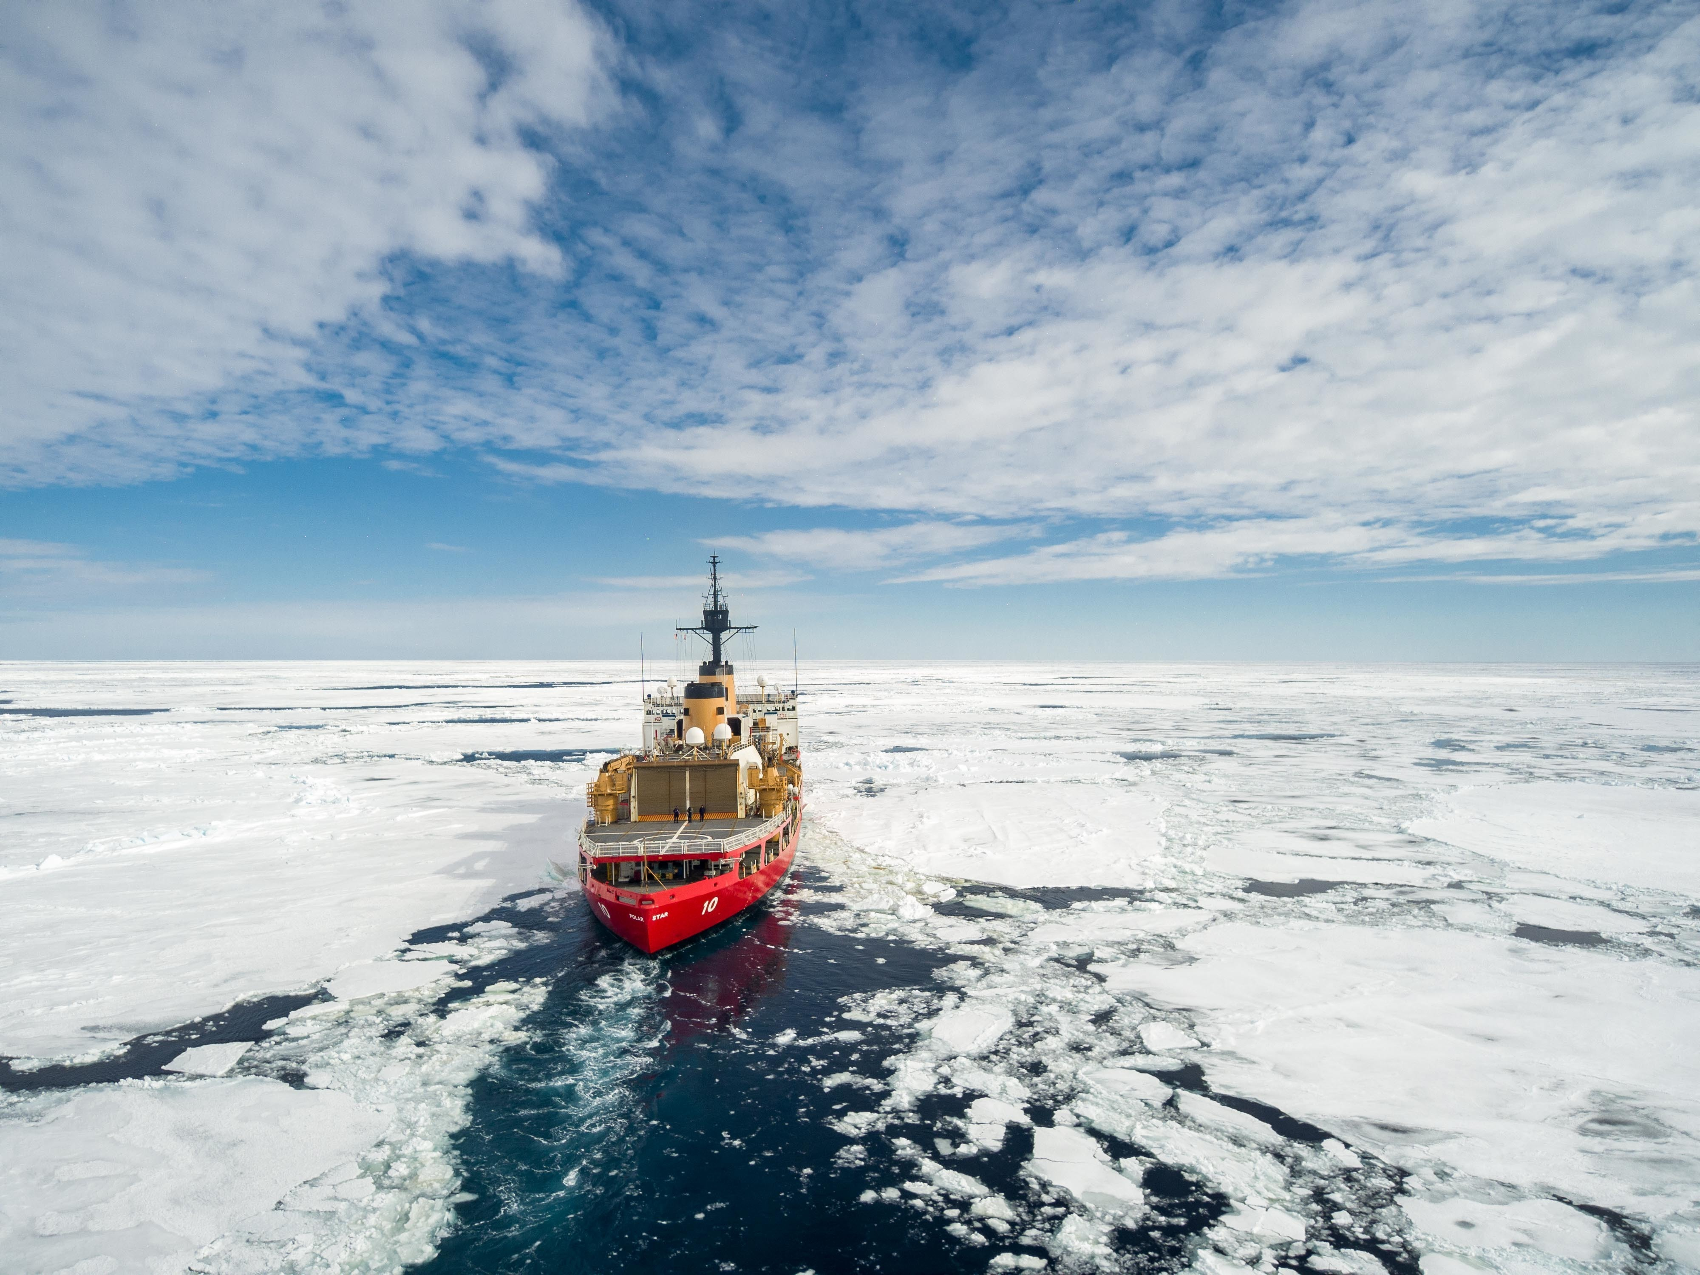
Control modes
Constant Power
Normal conditions when precise speed control not required.
Appropriate for use in heavy seas.
Reduces impact on prime mover.
Constant Speed
Used when precise speed control needed.
Appropriate for underway replenishment.
Constant Torque
Used when constant power could result in over torquing the shaft.
Appropriate for use in very high sea states, debris laden water, and ice laden water.
Coast Guard Cutter Polar Star (WAGB 10) transits through pack ice (USCG Photo)

Slide 13
Shaft Grounding System
Used to limit galvanic corrosion of the shaft and propeller.
Shaft grounding system often employ a metallic brush on the shaft that is electrically connected to the hull of the ship.
Shafts may include an insulating coupling to prevent the flow of shaft currents.

Slide 14
Cables
Interconnect electrical interfaces of equipment.
Incorporate design features to …
Mitigate the impact of common-mode currents.
Control the electric field within insulation to maximize insulation life.

Slide 15
Sources of losses
Motors, Motor Drives, Propulsion Transformers
No load losses.
Losses proportional to current squared.
Losses may be reduced by using multiple motors and motor drives on the same shaft – use only one motor and drive at low power levels.
Electrical Filters
No load losses.
Losses proportional to non-fundamental frequency current components squared.
Shaft Bearings and Thrust Bearings
Very low losses.
Cooling Systems
Power consumed by the cooling system is usually considered a loss.
Losses can be considerable at low power levels.

Slide 16
Operational Profiles
Objective: minimize losses at ship speeds that the ship operates for long periods of time.
If operate most of time at high speed, then high full-power efficiency is beneficial.
If operate most of time at low speed, then part-load efficiency is very important.
Multiple motors and motor drives per shaft.
Motors with better part load efficiency.

